Slide 2
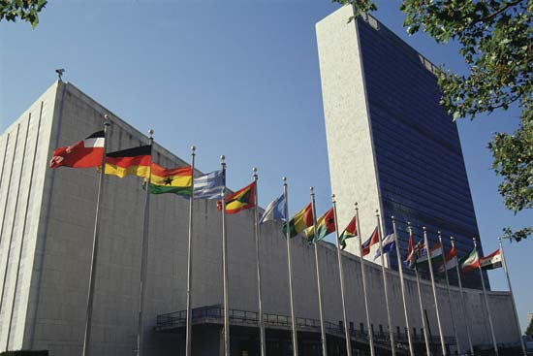
UNITED NATIONS 19TH ANNUAL CTAUN CONFERENCE ~ APRIL 6, 2018
NEW YORK CITY

Slide 3
19th Annual CONFERENCE ON TEACHING ABOUT THE UNITED NATIONS United Nations Building, New York City SAVE THE DATE: FRIDAY, APRIL 6, 2018
“Stepping Up to Protect the World’s Children”
http://www.ctaun.org/conferences/2018-un/

Slide 4
“Injustice anywhere is a threat to justice everywhere?” (Martin Luther King, Jr.) FRIDAY, APRIL 6, 2018
http://www.ctaun.org/conferences/2018-un/

Slide 5
“Promises made to children are sacred.” Nelson Mandela CTAUN exists to provide opportunities for educators to learn, understand and appreciate the work of the UN, and to incorporate global awareness into curricula and school activities at all levels.
http://www.ctaun.org/conferences/2018-un/

Slide 6
19th Annual CONFERENCE ON TEACHING ABOUT THE UNITED NATIONS United Nations Building, New York City SAVE THE DATE: FRIDAY, APRIL 6, 2018
“Stepping Up to Protect the World’s Children”
http://www.ctaun.org/conferences/2018-un/

Slide 8
ANNIVERSARY BOOKLET 1986 -- 2016

Slide 9
2016 Omega State Anniversary Booklet
*AVAILABLE AT STATE LEADERSHIP CONFERENCE
* MUST BE ORDERED AND PAID BY APRIL 1, 2018
BOOKLET WILL BE APPROXIMATELY 180 PAGES
WILL INCLUDE THE PAST 30 YEAR HISTORY OF ALL CHAPTERS

Slide 10
2016 Omega State Anniversary Booklet
WILL INCLUDE A BIENNIUM SUMMARY OF PAST STATE PRESIDENTS 1986-2016
WILL INCLUDE RECORDS OF SCHOLARSHIPS, INTERNATIONAL SERVICE, OMEGA STATE AWARDS
FOUNDING HISTORY AND SIGNIFICANT MEMBERS
AND THEIR IMPACT TO OMEGA STATE

Slide 11
COVER
PAGE

Slide 12
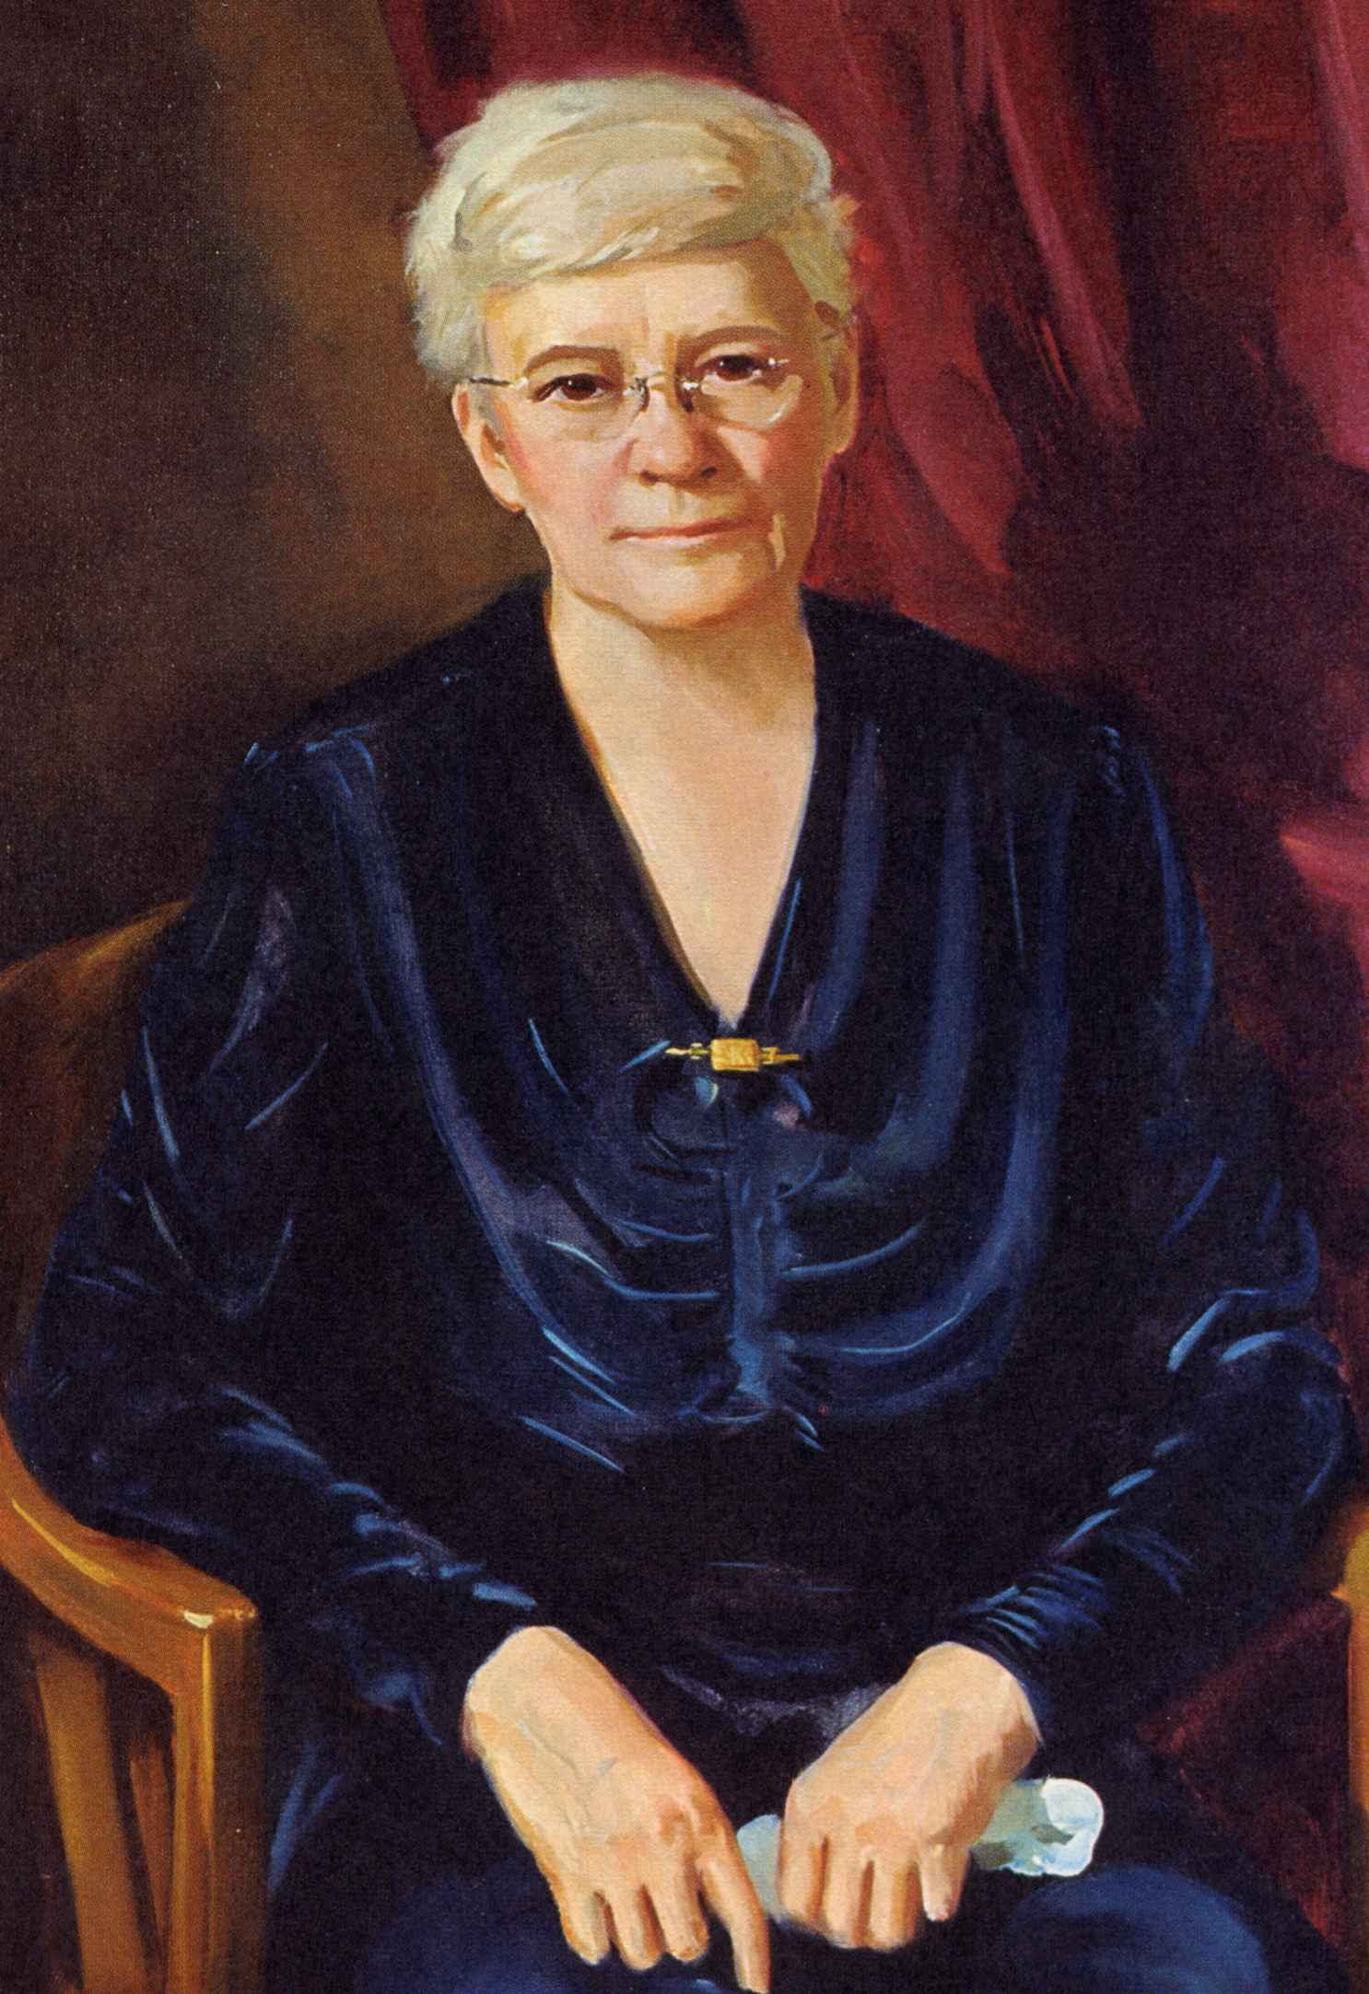
“ DELTA KAPPA GAMMA IS BORN”
Dr. Annie Webb Blanton weaved her plan to expand each state in a quick and expedient manner.
The chapters began around university and college campuses where there was a strength not unlike other state organizations across the U. S.
In Hildegard Sweet’s presidency, 1936-1940,
fifteen chapters were chartered.
Omega State hosted the 9th Annual National Convention in Denver in 1938.
Mamie Sue Bastian’s theme was “ I will lift up mine eyes unto the mountains.”
By now, Dr. Annie Webb Blanton’s role had changed to executive secretary.

Slide 13
The founders of Omega State were charged with chartering new chapters across the state and were specifically chosen with this job in mind.
ALPHA CHAPTER ~ 1937 ~ DENVER
BETA CHAPTER ~ 1937 ~ PUEBLO
GAMMA CHAPTER ~ 1937 ~ BOULDER
DELTA CHAPTER ~ 1937 ~ GREELEY
EPSILON CHAPTER ~ 1937 ~ DURANGO
EARLY CHAPTERS WERE ORGANIZED AT THE COLLEGES IN THE STATE.
CHAPTER
PAGES

Slide 14
ELEANOR WHEAT ~ 1985 -- 1987 ~ IOTA CHAPTER, TRINIDAD
JOAN SHOEMAKER ~ 1987 – 1989 ~ THETA CHAPTER, STERLING
FRANCES DUFRAINE ~ 1989 – 1991 ~ GAMMA CHAPTER, BOULDER
ETC.
PAST
PRESIDENT’S
PAGES

Slide 15
1986 ~ LOOKING TO THE FUTURE
1986—1996 DEDICATION AND CHANGING TIMES
1996—2006 GROWTH AND TECHNOLOGICAL INFLUENCES
2006 -- 2016 IMPACTING EDUCATION WORLDWIDE
2016—2017 LOOKING TO THE FUTURE
*HISTORICAL
CAPSULES
EACH DECADE

Slide 16
PAGES OF SERVICE AND AWARDS
*ACTIVITIES AND CONTRIBUTIONS OF
OMEGA STATE MEMBERS
* OUR BEGINNINGS: INSPIRATION AND SERVICE
HILDEGARDE SWEET, KATHERINE GLENDINNING
CARRIE MCMILLAN, RUTH HARDIMAN
*HONORING INTERNATIONAL SERVICE
ADMINISTRATIVE BOARD MEMBERS AND
INTERNATIONAL OFFICERS
INTERNATIONAL COMMITTEE MEMBERS
*SIGNIFICANT EVENTS IN COLORADO
-1987 SOUTHWEST REGIONAL
-2011 SOUTHWEST REGIONAL
-2011 SEVENTY FIFTH DIAMOND ANNIVERSARY OF OMEGA STATE

Slide 17
CONFERENCES, CONVENTIONS,
HONORS
*ACTIVITIES AND CONTRIBUTIONS OF
OMEGA STATE CHAPTERS AND MEMBERS
*HONORS
OMEGA STATE AWARDS / CITATION OF MERIT AWARDS
*SERVICE THROUGH SCHOLARSHIPS, WORLD FELLOWSHIPS,
*OMEGA STATE SERVICE
EXECUTIVE SECRETARIES, TREASURERS,
EDITORS OF THE PEAKS, PUBLICATIONS, WEB MASTERS
*SPECIAL TRIBUTES
*OMEGA STATE MUSICIANS

Slide 18
ANNIVERSARY BOOKLET 1986 -- 2016

Slide 20
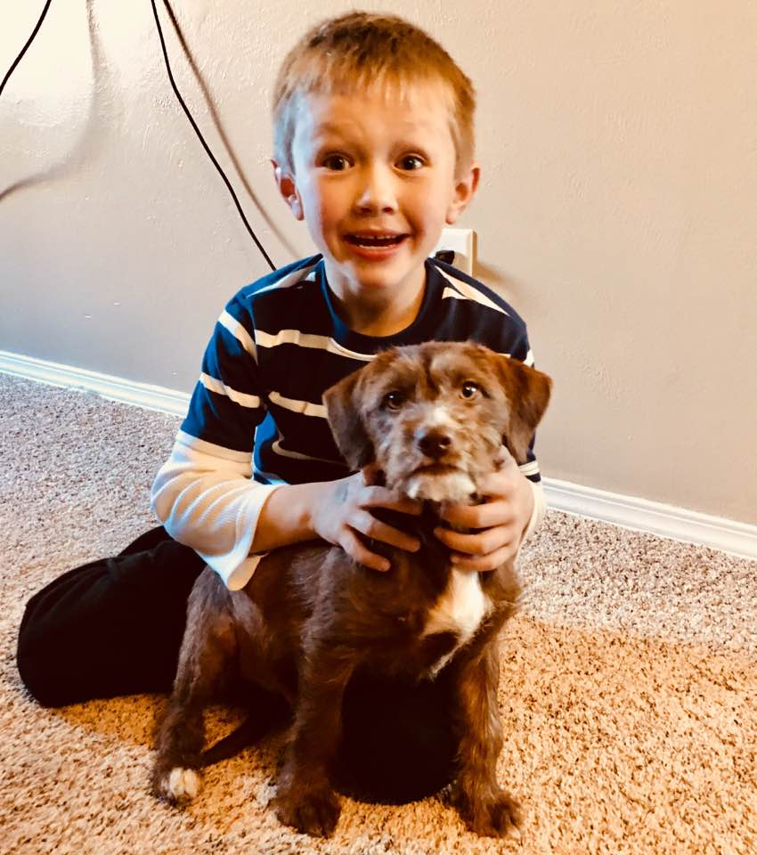
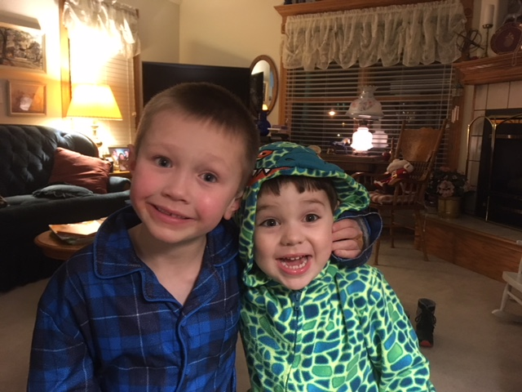
Porter and Dermot
and Max, the Dog !

