Slide 1
Delta Chapter’s Support of Early Educators University of Northern Colorado Cumbres Student Teacher Scholarship & Centennial Elementary School Early Career Educators

Slide 2
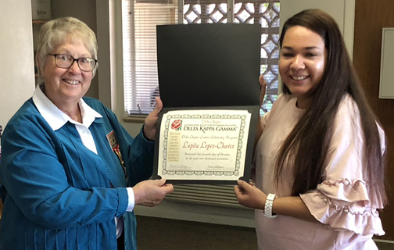
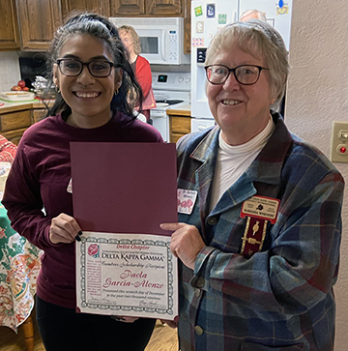
The University of Northern Colorado changed their general scholarship fund policy so the chapter could no longer designate a specific recipient. Delta member, Dr. Barbara Whinery, investigated alternatives and learned of the Cumbres Program at UNC which supports and helps fund those who choose to be Teachers of English as a Second Language. In cooperation with Cumbres we now award a scholarship to a female during her semester of student teaching. We have awarded scholarships in 2017 and 2019 and will be awarding a third in 2021.
Above: Dr. Barbara Whinery with 2017 Awardee, Lupita Lopez-Chavez. At Right: 2019 Awardee Paola Garcia-Alenzo with Dr. Whinery.

Slide 3
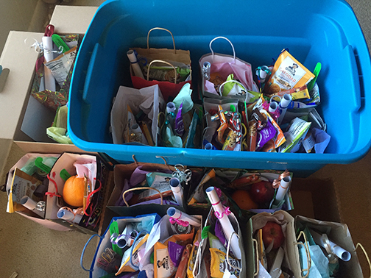
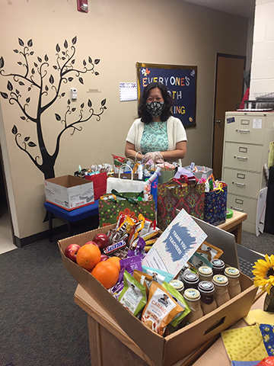
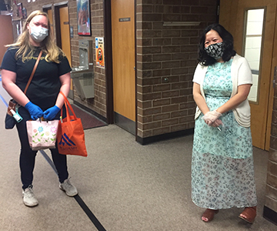
In 2019 Delta Chapter wanted to do more for early educators. Fortunately, Delta Member Dr. Amie Cieminski knew that Centennial Elementary School in the Greeley-Evans School District had a principal new to the school and a large number of early educators at the same time. Through Dr. Cieminski’s leadership the chapter had two after school in-person events the first semester of 2019. In March, 2020, the pandemic prevented after school events, so Dr. Cieminski led the Early and Career Educators’ team, putting in much work herself, in alternative ways to let the Centennial early educators know they had support.
In May 2020 “goodies” gift bags were prepared so when the teachers returned to the building to building to clean out their rooms, each early educator was given a bag and extra treats were also available.

Slide 4
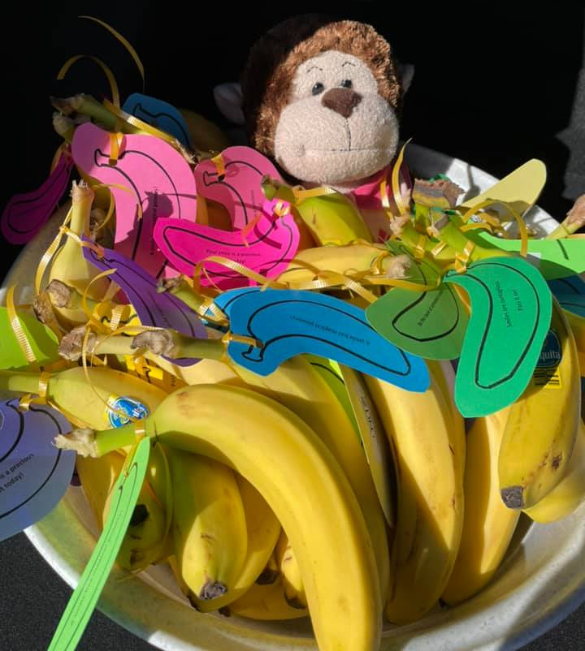
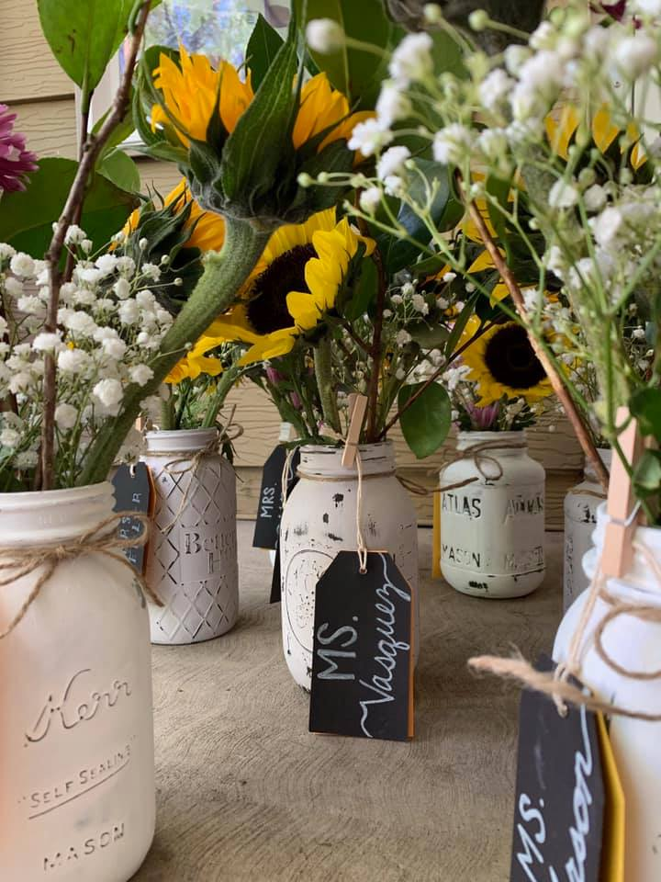
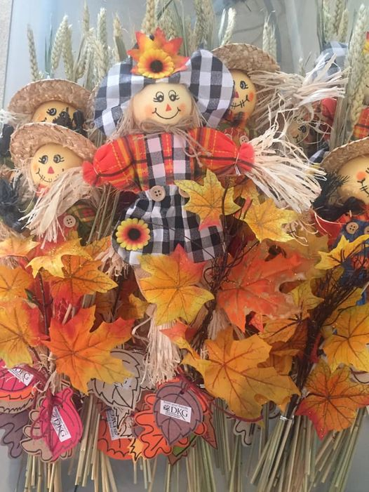
In addition, e-cards, notes, and Holiday cards were sent to the Centennial early educators. Other small gifts continue to be sent to the early educators. In May, 2020, the chapter was able to host an after school in person event at a local restaurant.
Bananas & Smiles. August back to school vases. October vase fillers.

Slide 5
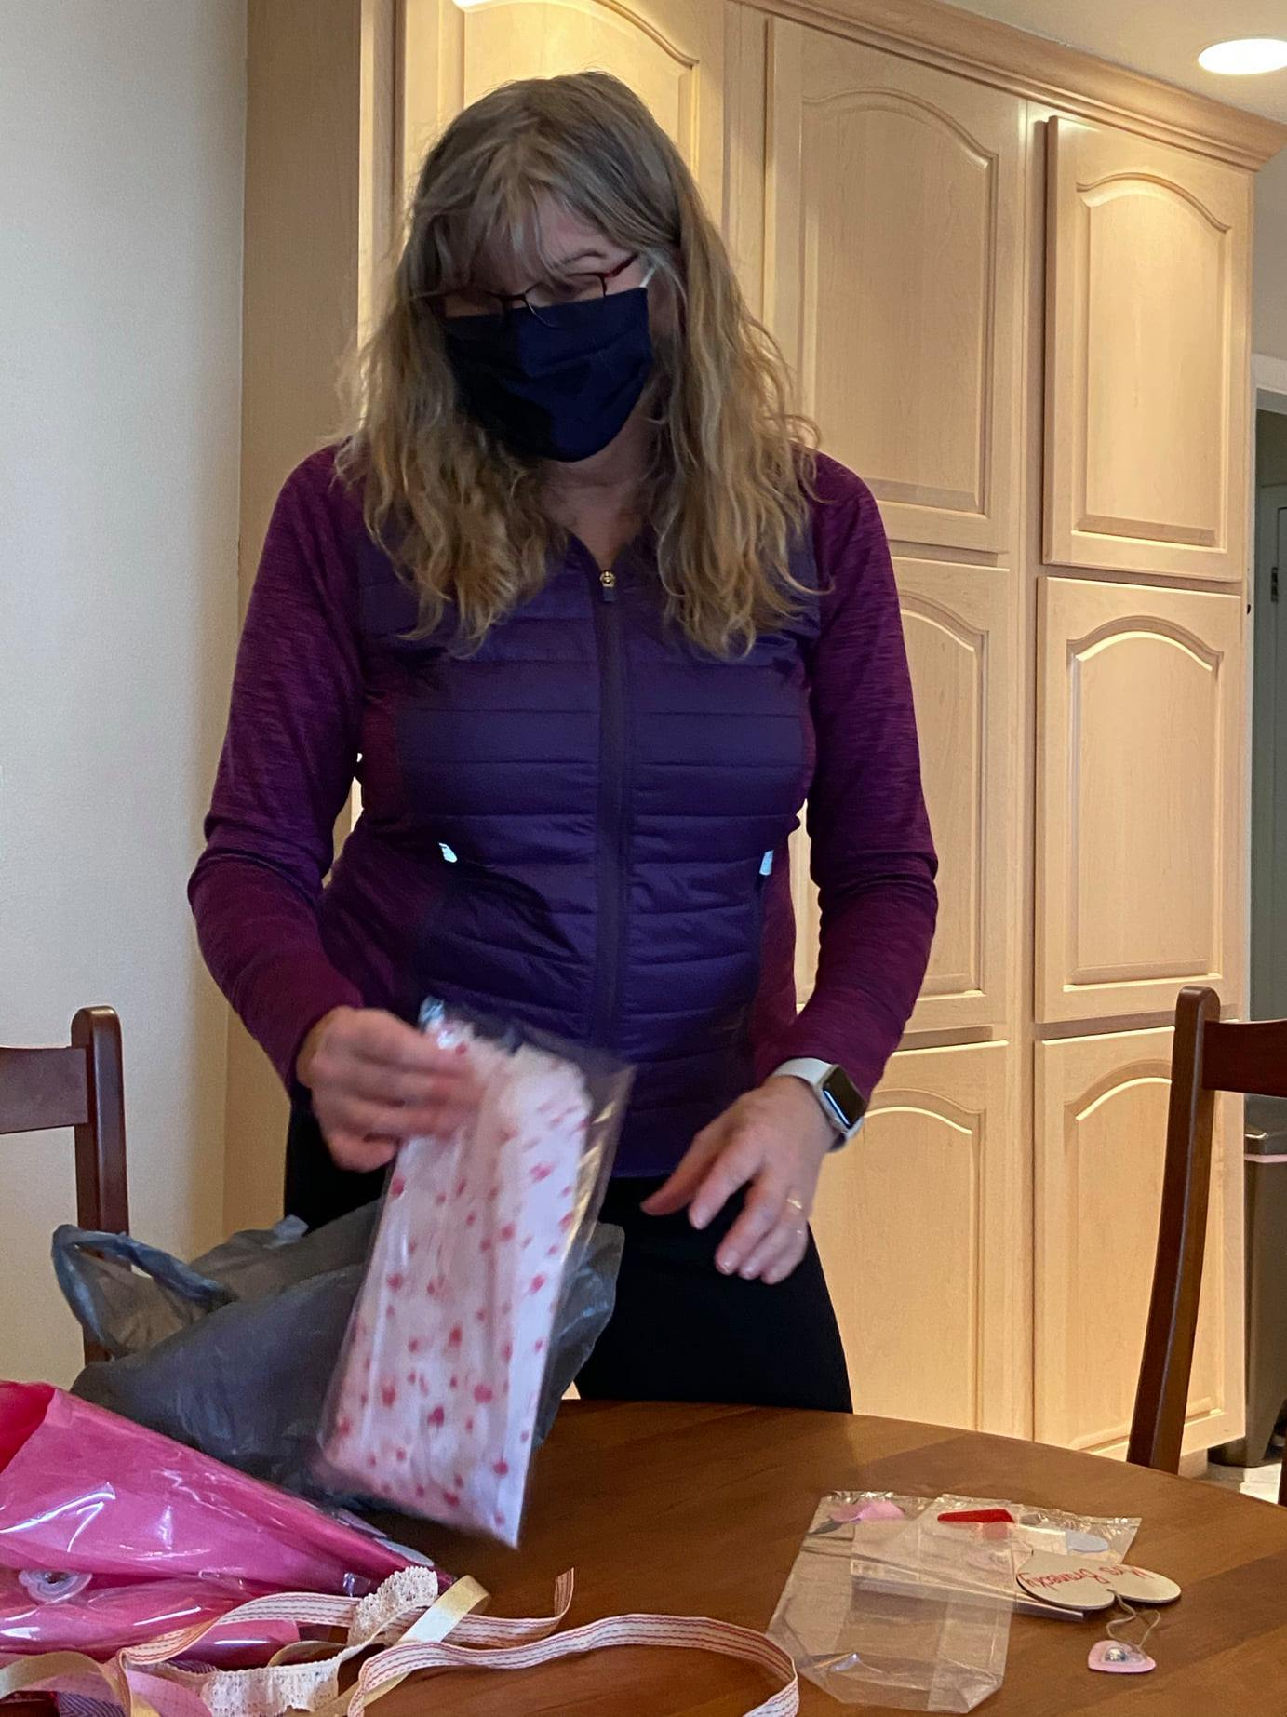
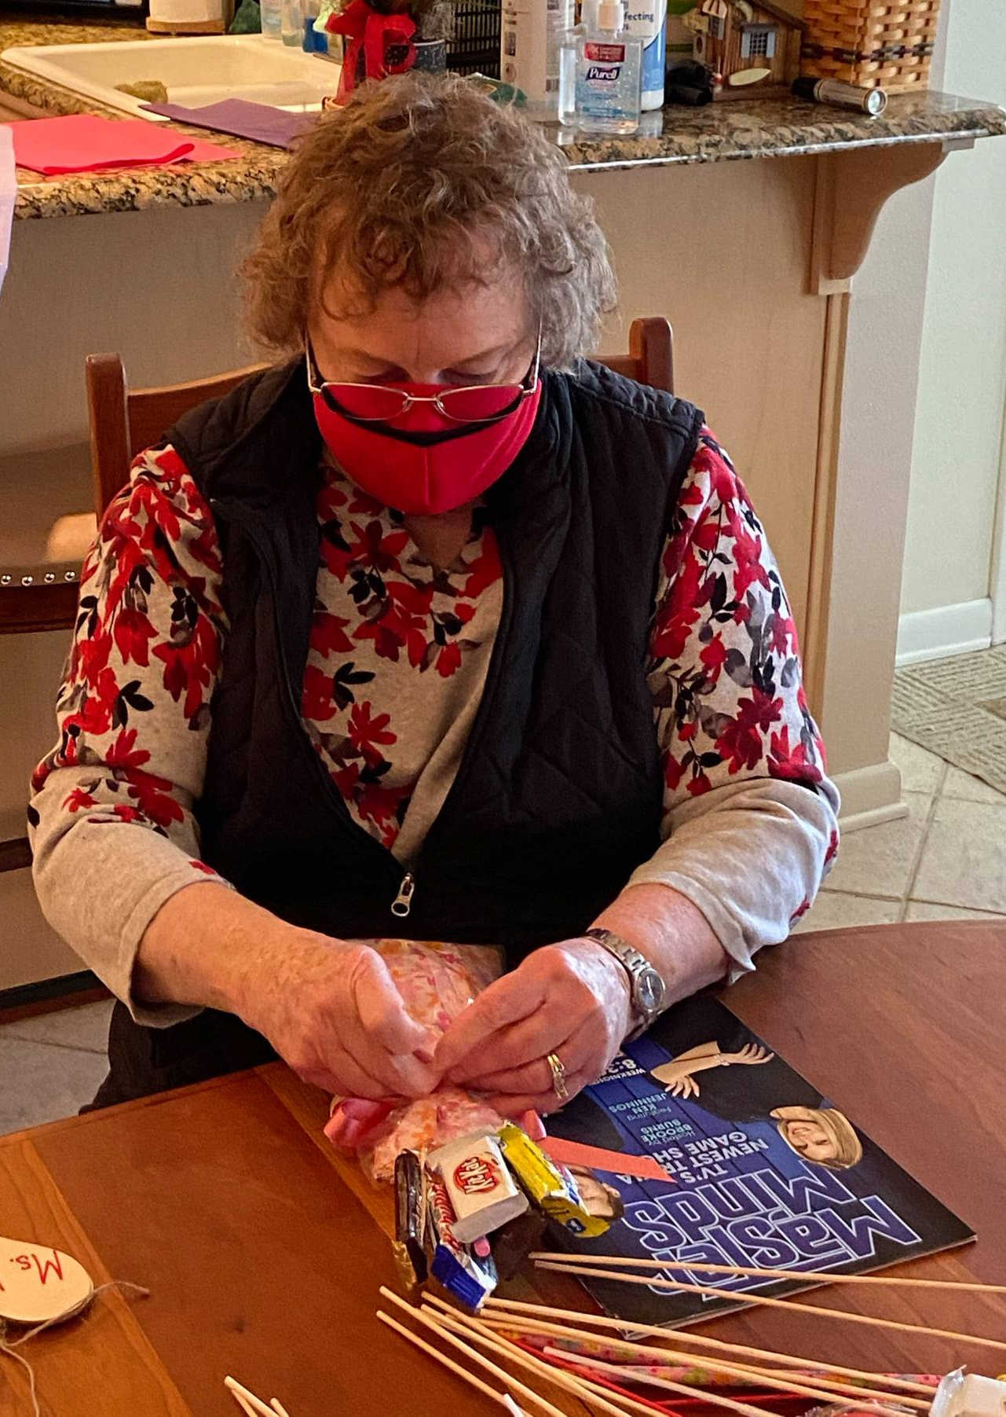
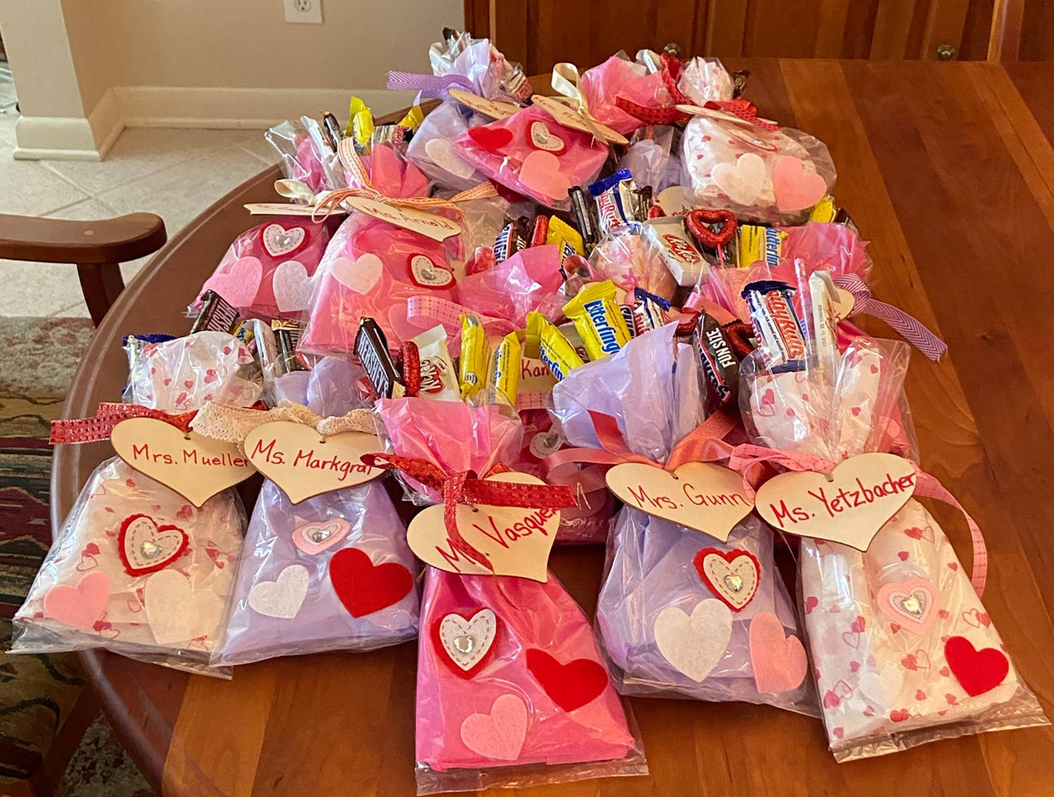
VALENTINE’S
DAY!
Dr. Amie Cieminski (above) and Nancy Robinson (at right) work on Valentine treat bags.

Slide 6
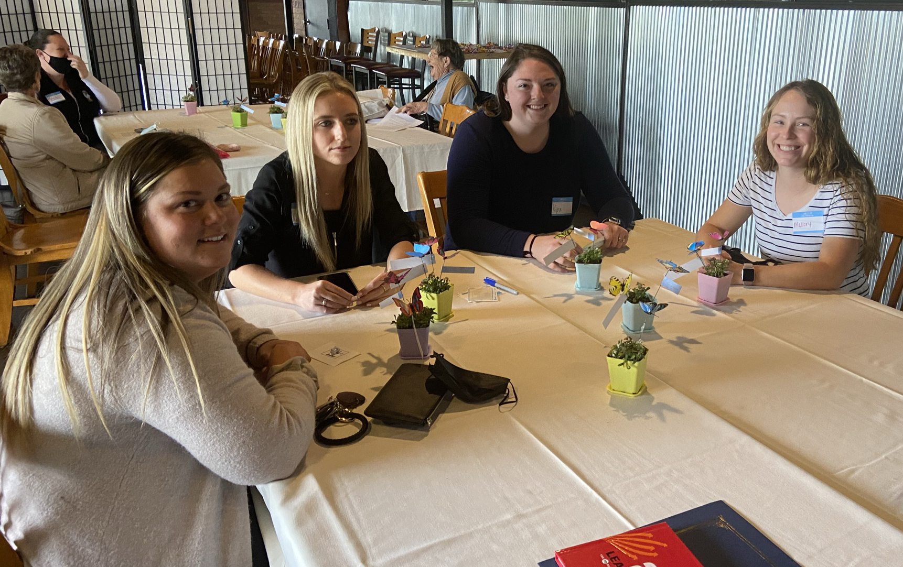
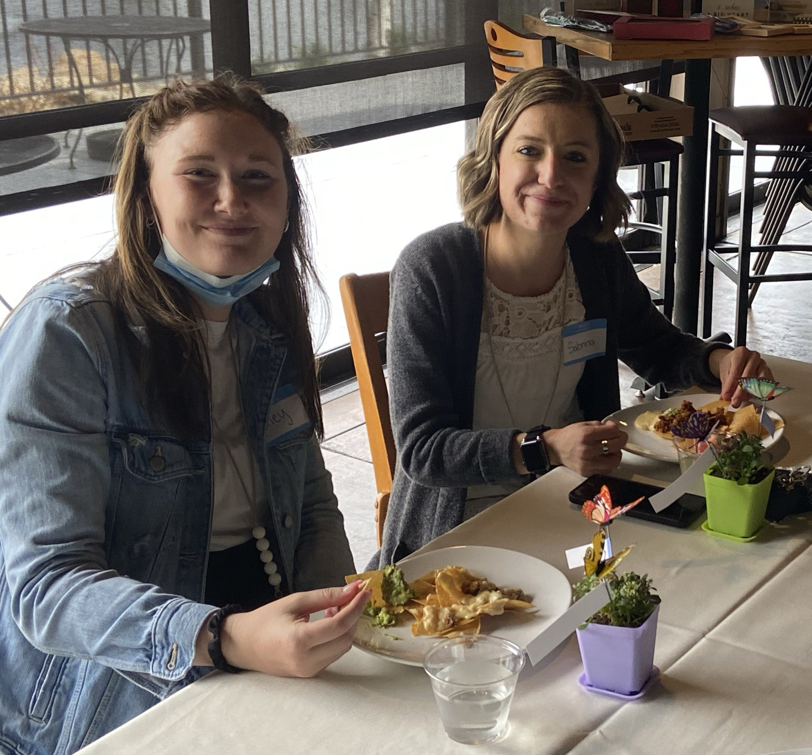
Delta’s treating Centennial early career educators in May 2020 celebrating them, especially having to teach online, pivoting rapidly in March.

Slide 7
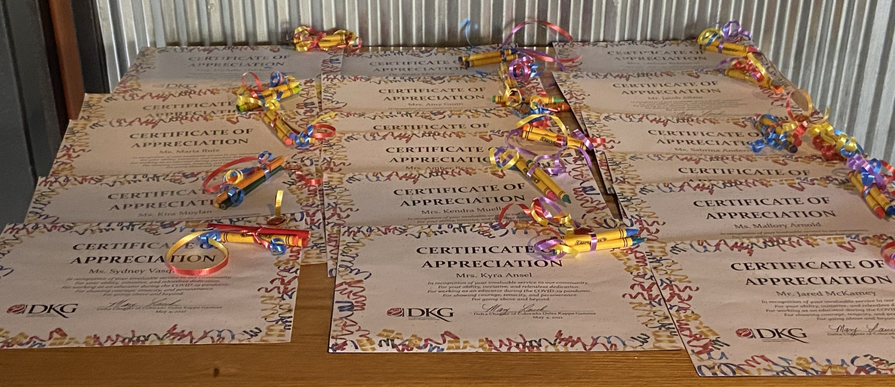
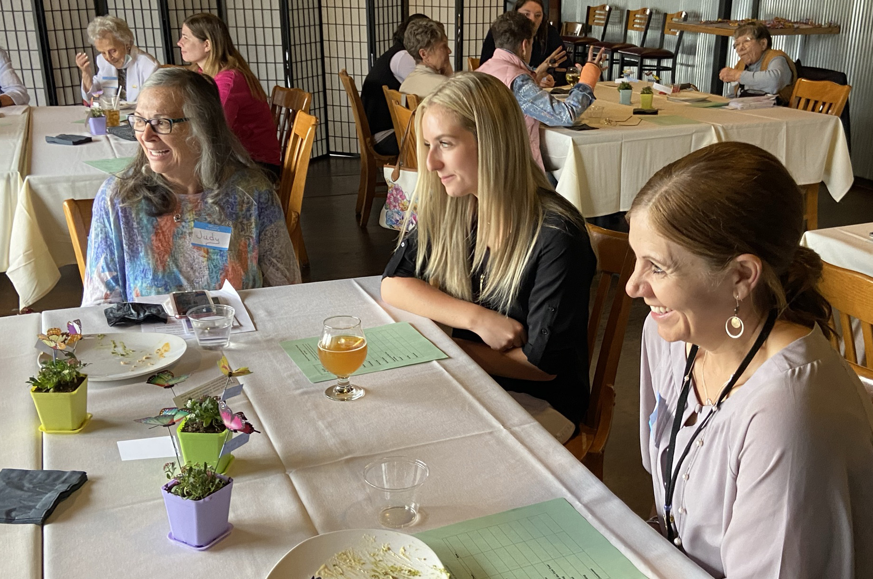
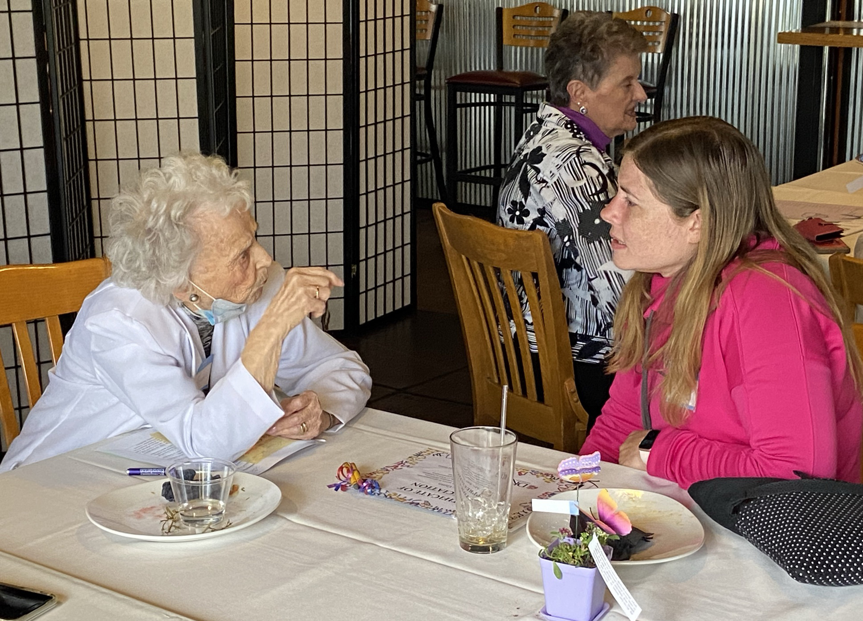
More from May 2020

Slide 8
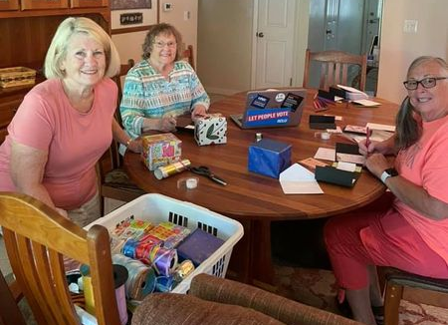
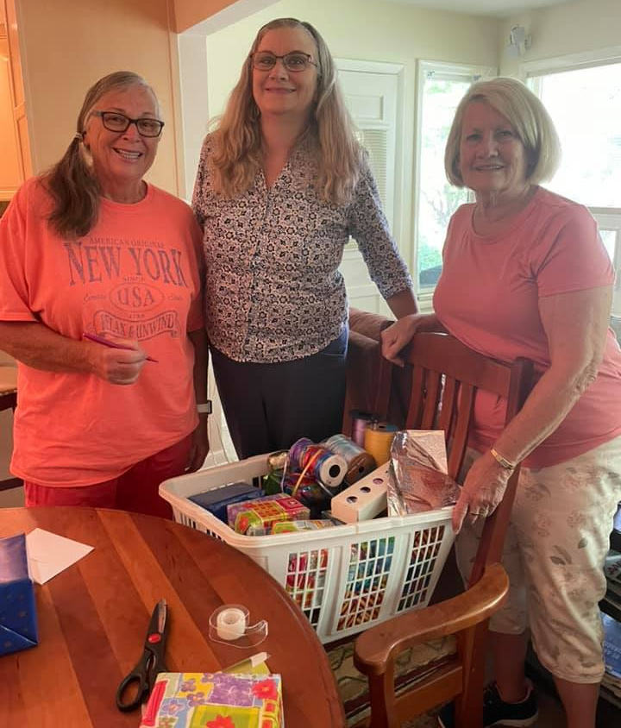
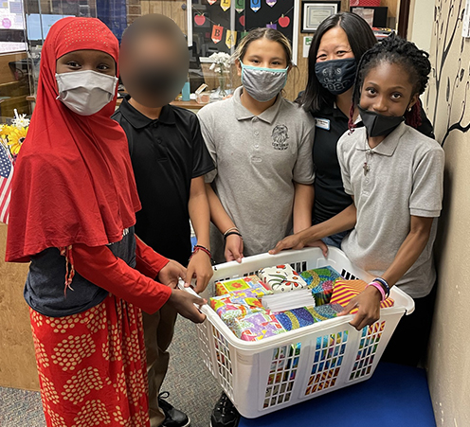
Delta early educators team prepares notes and mugs, September 2021.
When the mugs with notes got to Centennial, Principal Angie enlisted a few students to help in the distribution. More to come this year!

